Slide 1

POKEDEX
A DYNAMIC POKÉMON EXPLORER WEB APP WITH ADVANCED SEARCH, FILTERING, COMPARISON, AND FAVORITES FEATURES USING REACT AND THE POKÉAPI.

Slide 2

CONTENT
INTRODUCTION & OBJECTIVES
TECH STACK
MODULES
GLIMPSES OF OUR WEBSITE
FUTURE SCOPES
CONCLUSION

Slide 3


OBJECTIVES
Introducing a Query Website:
Pokédex Explorer is a dynamic and interactive web application designed for Pokémon enthusiasts to explore, compare, and learn about their favorite Pokémon. Leveraging the PokéAPI, this platform provides a seamless experience to view detailed Pokémon information, filter by attributes, compare stats, and build a personal list of favorites. With an engaging UI and smart features, it serves as a digital encyclopedia that brings the Pokémon world to your fingertips.
To create an interactive web platform where users can explore Pokémon data in depth — with advanced features like comparison, filtering, detailed views, and favorites — using the PokéAPI. It serves as a digital encyclopedia for Pokémon fans, combining speed, usability, and functionality.

Slide 4


TECH STACKS
Frontend
State Management
API
PokéAPI
https://pokeapi.co/#google_vignette
React.js
React Router
Context API
CSS Modules
React Context API
LocalStorage

Slide 5
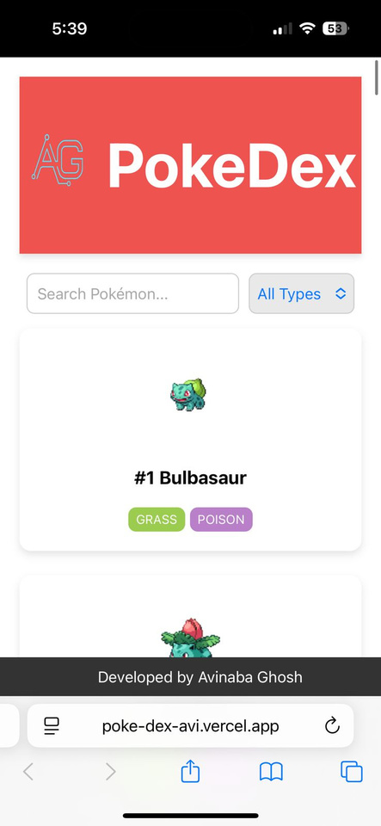

MODULES
A person should be able to
A person should be able to
Pokémon Listing with Pagination
Pokémon Comparison Tool
Random Pokémon Generators
Error Boundaries for Safe UX
Filtering & Sorting (by type, stats, etc.)
Detailed Pokémon Information View
Add to Favorites (stored via LocalStorage)

Slide 6

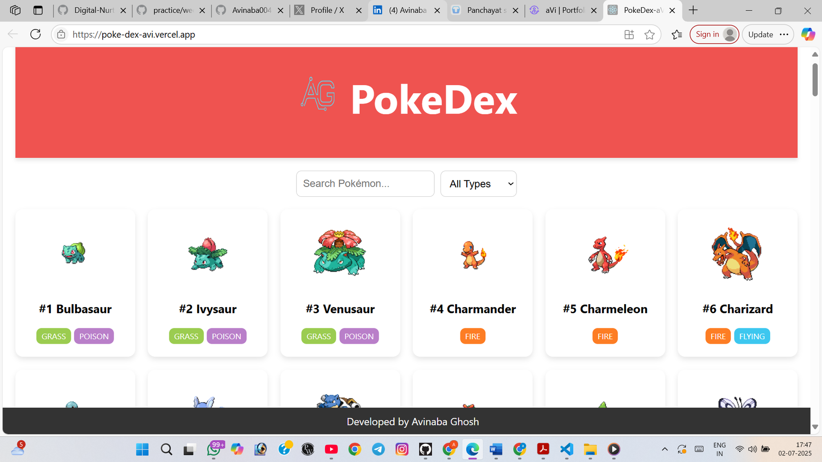

LANDING PAGE
NORMAL
MATERIAL
UI DESIGNS
USING
REACT CSS

Slide 7

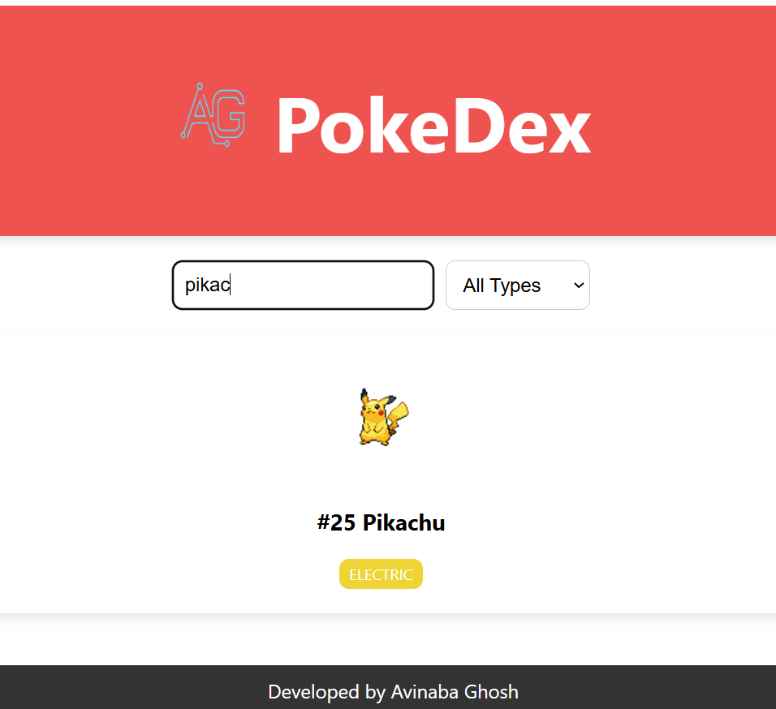
SEARCH BY NAME

Slide 8
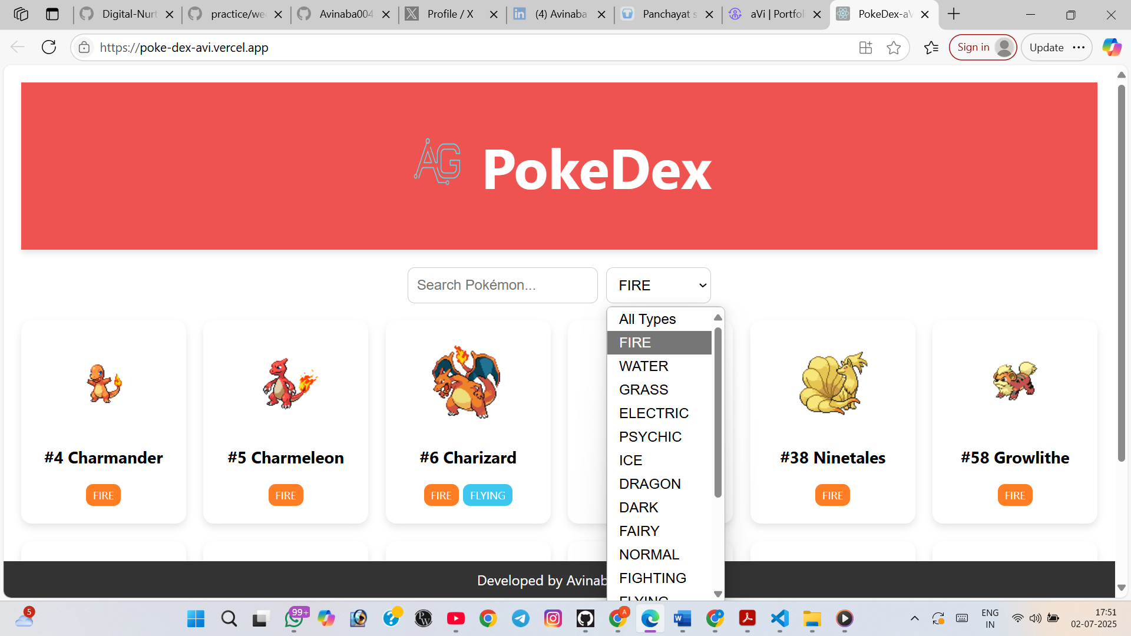

CATEGORY SEARCH
01

Slide 9



FUTURE SCOPES
Implement PWA for offline Pokémon access
Add type-based battle suggestions
Add a user login module to sync favorites across devices
Animated sprite previews
Leaderboard or stat-based ranking system

Slide 10




CONCLUSION
Building the Pokédex Explorer helped me gain practical experience in full-stack web development using modern tools and libraries. I deepened my understanding of React.js, React Router, and Context API for efficient state management and routing. By integrating the PokéAPI, I improved my skills in working with real-time RESTful APIs and handling asynchronous data. I also learned how to enhance user experience through features like localStorage, custom hooks, error boundaries, and component optimization. This project significantly strengthened my ability to build scalable, responsive, and user-friendly web applications.

Slide 11

THANK
YOU
Submitted by:-
Avinaba Ghosh

